Slide 1
Budweiser Case study
Data Scientist: Daanesh Ibrahim

Slide 2
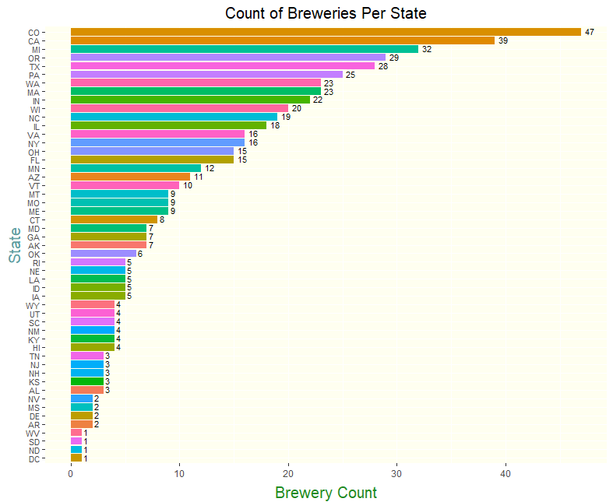
Breweries by State
Things to Note:
Colorado has highest the amount of breweries with 47
The following states are tied for having the lowest amount of breweries:
West Virginia
South Dakota
North Dakota
District of Columbia.

Slide 3
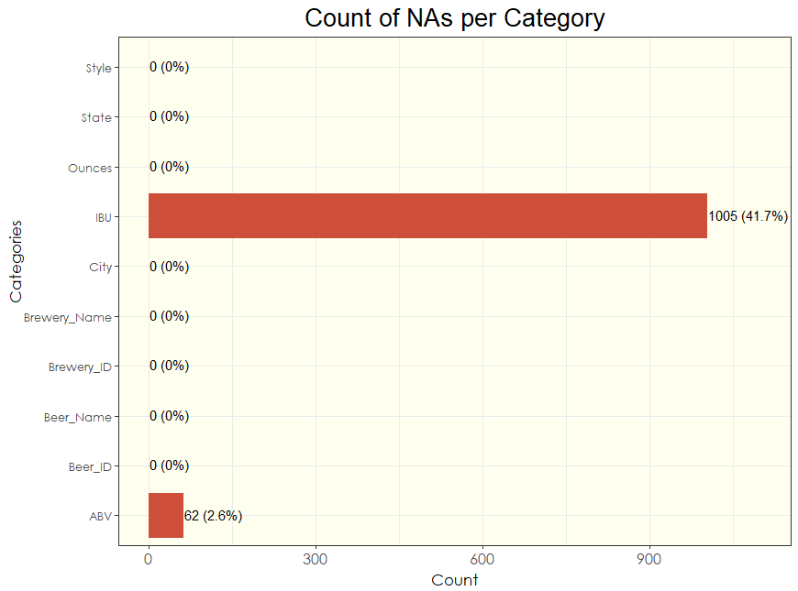
Count of Missing Data (NAs)
Of the 2,410 rows of data from the combined datasets:
IBU has 1,005 blanks (41.7%)
ABV has 62 blanks (2.6%)

Slide 4
“Fill in the Blanks”
What should we replace the NA values with? Mean or Median?
Mean is a better measure of central tendency but is affected by potential outliers in the data.
Median is a better measure of the middle set of data and is resistant to outliers
Best way to look at the data is boxplots for ABV an IBU. This will tell us if there are outliers in the datasets in order to make our decision.

Slide 5
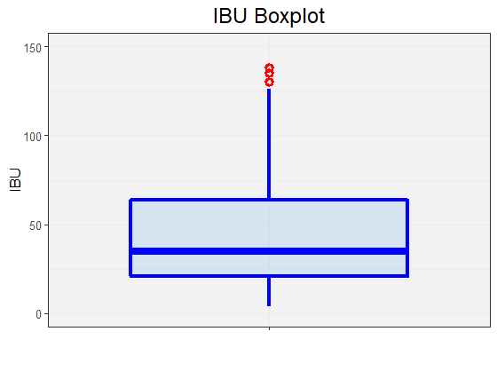
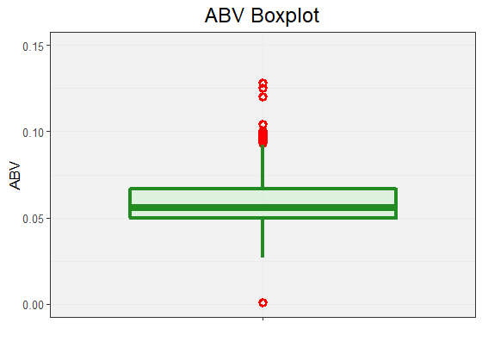
“Fill in the Blanks”
What should we replace the NA values with? Mean or Median?
Mean is a better measure of central tendency but is affected by potential outliers in the data.
Median is a better measure of the middle set of data and is resistant to outliers
Best way to look at the data is boxplots for ABV an IBU. This will tell us if there are outliers in the datasets in order to make our decision.

Slide 6
“Fill in the Blanks”
NA Values for ABV and IBU are replaced by the respective median value for that state.
For states with no values for ABV and IBU, we will use the nationwide median values.
The only state that has only NAs was South Dakota for their IBU values. Therefore the national median of 35 was applied to their IBU values.

Slide 7
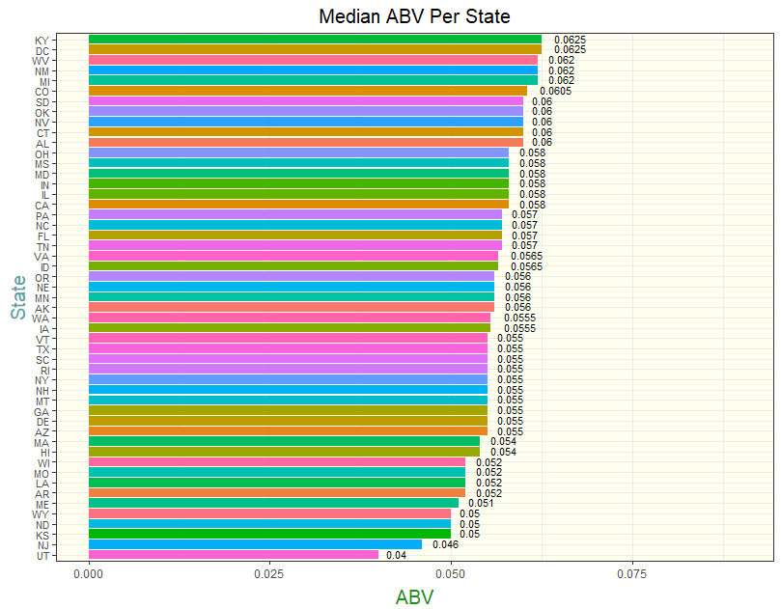
Median ABV Per State
Kentucky and District of Columbia are tied with the highest median ABV (0.625).
Utah has the lowest median ABV out of all of the states (0.04).

Slide 8
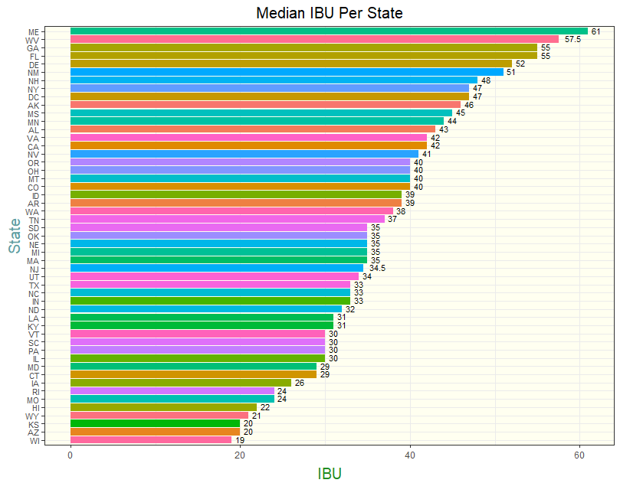
Median IBU Per State
Maine has the highest median IBU (61).
Wisconsin has the lowest median IBU (19).

Slide 9
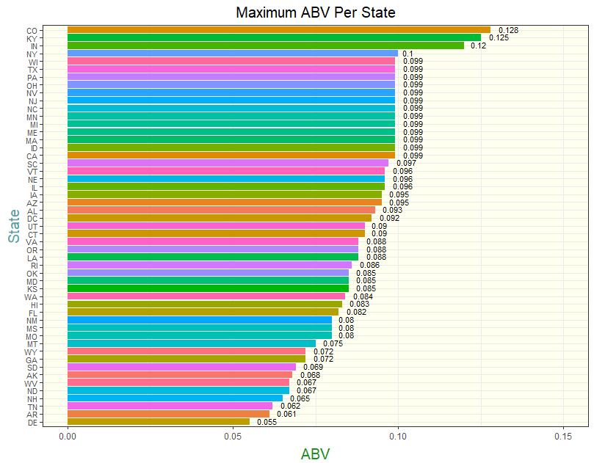
Maximum ABV Per State
Colorado has the highest maximum ABV out of all of the states with 0.128
Delaware has the lowest maximum ABV out of all of the states (0.055).

Slide 10
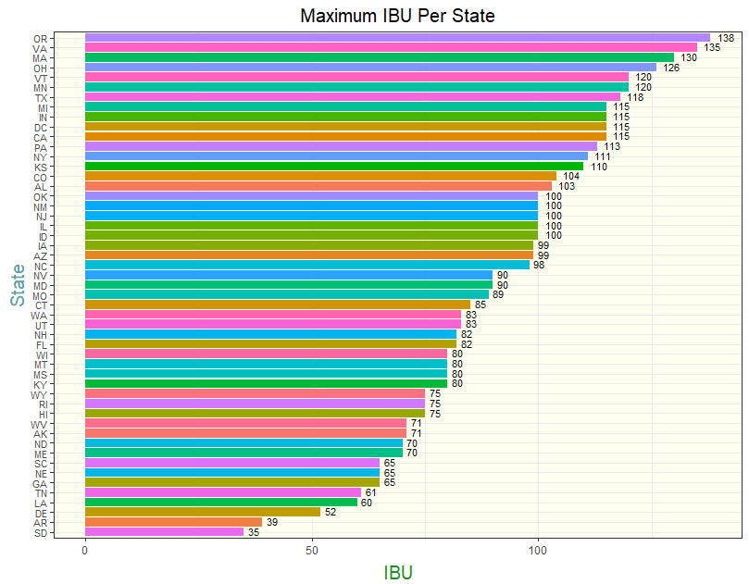
Maximum IBU Per State
Oregon has the highest maximum IBU with 138.
Arkansas has the lowest maximum IBU with 39 on this list (South Dakota is using the national median).

Slide 11
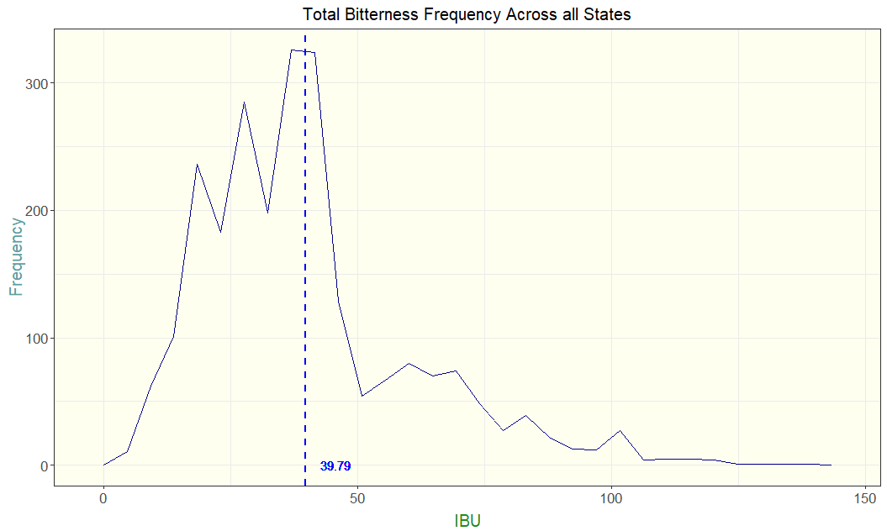
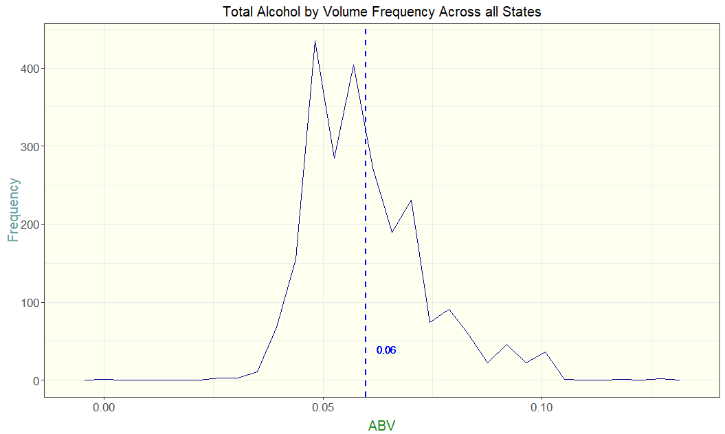
Summary Statistics
Frequency Distributions show us our counts of ABV and IBU across all states.
The mean of IBU is near the peak of the highest count of IBU among all states.
The mean of ABV is further from the highest count of ABV among all states. This tells us there are more outliers for ABV skewing the mean that may not be in line with the total counts of ABV.

Slide 12
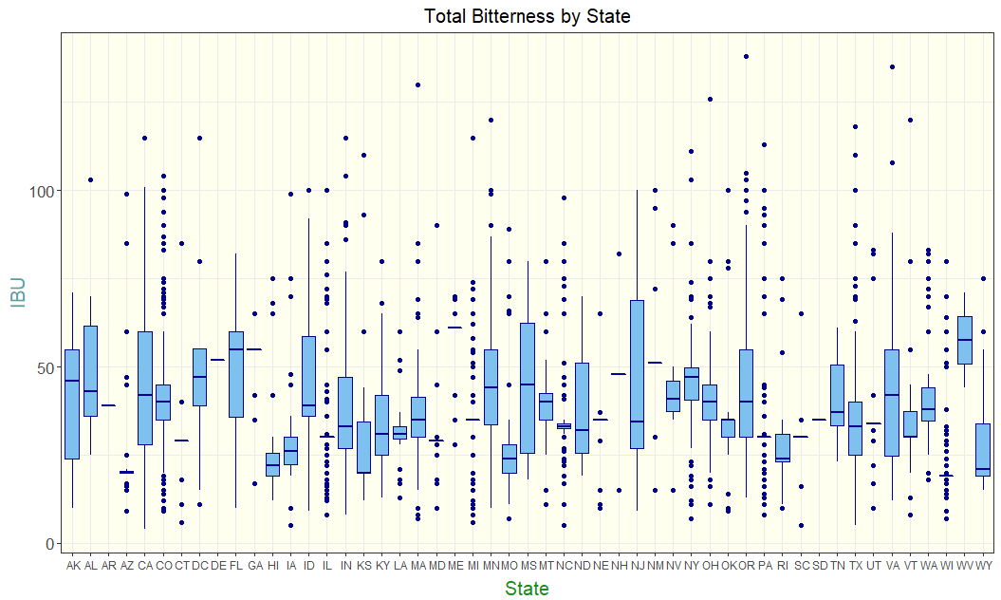
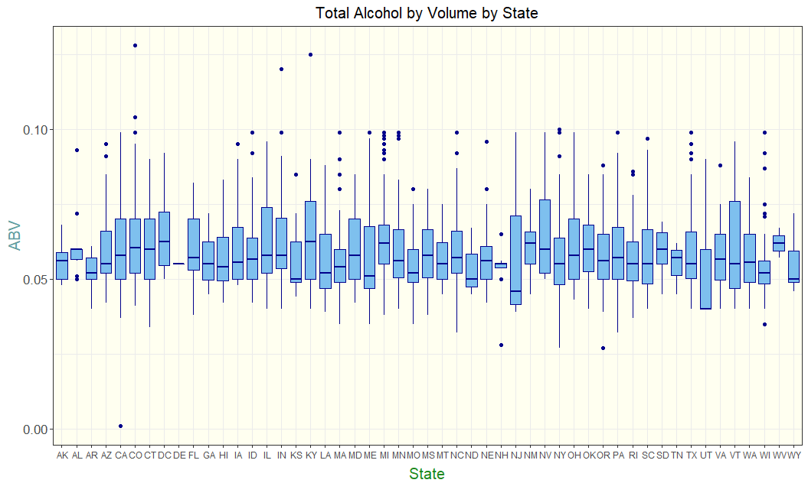
Summary Statistics
Boxplots show us our data summaries of ABV and IBU for each state.
IBU for California seems to be the most uniform across the state with the median being between the quartiles evenly and only one outlier
Though Colorado has the highest value alcohol by volume, this might be considered an outlier and should be taken into account when figuring out where to release products first with high ABV. Kentucky might be a better state to release a higher AVB product.

Slide 13
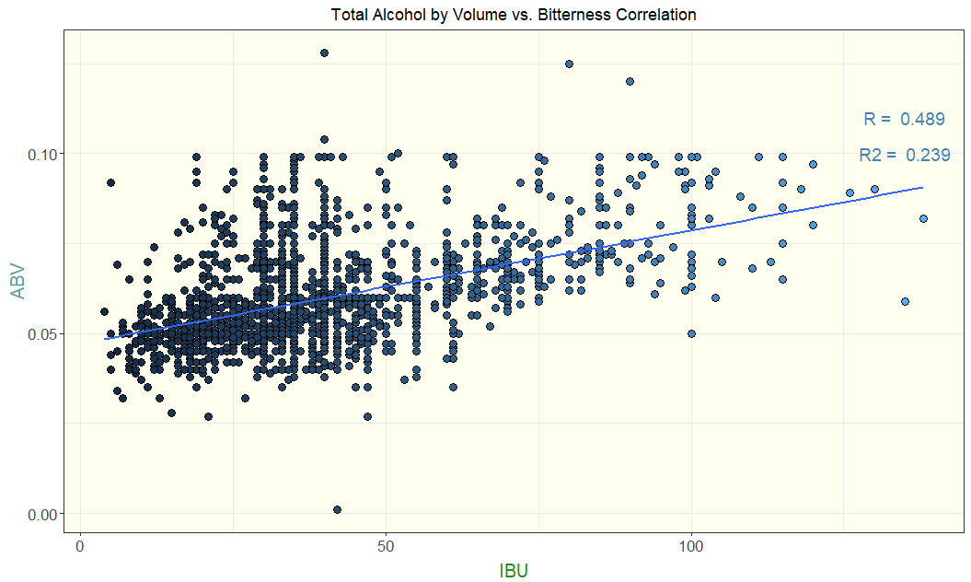
ABV vs IBU
Scatterplot of ABV vs IBU. Is there a relationship?
There is a positive relationship between the two variables
The correlation is 0.489, corresponding with a moderate relationship between ABV and IBU.
The coefficient of determination, or R², tells us that 23.9% of the variation in ABV values can be determined by variation of IBU values in this model.

Slide 14
ABV vs IBU
Scatterplot of ABV vs IBU. Is there a relationship?
There is a positive relationship between the two variables
The correlation is 0.489, corresponding with a moderate relationship between ABV and IBU.
The coefficient of determination, or R², tells us that 23.9% of the variation in ABV values can be determined by variation of IBU values in this model.

Slide 15
ABV vs IBU
Scatterplot of ABV vs IBU. Is there a relationship?
There is a positive relationship between the two variables
The correlation is 0.489, corresponding with a moderate relationship between ABV and IBU.
The coefficient of determination, or R², tells us that 23.9% of the variation in ABV values can be determined by variation of IBU values in this model.

Slide 16
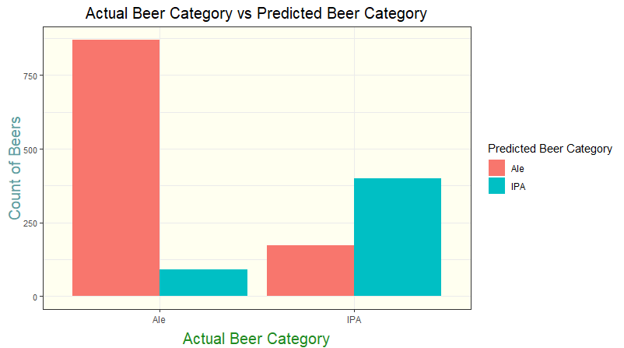
KNN
How well does ABV and IBU relate to IPAs and other Ales?
According to the model, we can successfully use the KNN model to correctly predict whether a beer is an Ale or IPA based only on their ABV and IBU 80% of the time.
We have a higher success rate predicting Ales (88.1%) vs IPAs (67.1%)

Slide 17
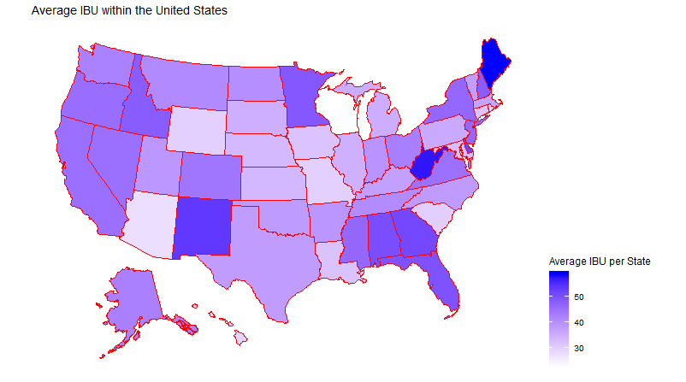
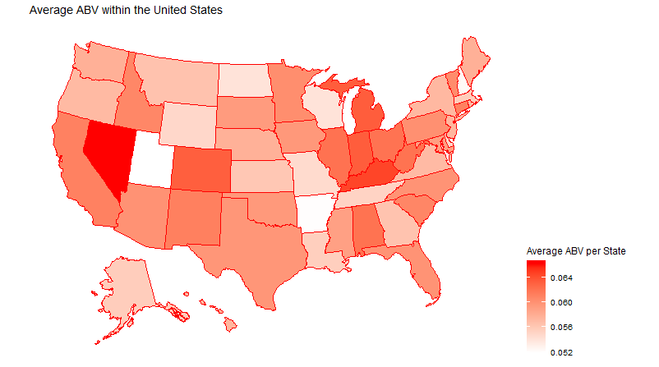
Additional Data
Can we use average IBU and ABV in any metric confidently?
Looking at the average IBU and ABV trends by region of the United States could be beneficial on where to release certain types beer.
Higher IBU beers would benefit from being released in the Southeast corner of the country (Florida region and surrounding states)
Higher ABV beers would benefit from being released in the Western states, including California, Nevada, and Arizona.

Slide 18
Questions

